Slide 1
Poster Presentation and Viva
ENG6200 Individual Honours Project

Slide 2
The Assessment
10% of Module Marks.
Your presentation should last for no more than 10 minutes!
The Viva Voce Examination (questions and defence).
Submit as a single PowerPoint slide by noon on 26th April.
You must present your poster to get marks for this element.

Slide 3
Format
Live presentation (in-person on campus or Teams TBC).
Visual aid should be the poster you have created.
Poster templates are available on Moodle.
~5 mins of questions

Slide 4
Example Contents
You should include:
Title.
Aim and objectives.
Short(!) Background.
A summary of the results.
An overview of the Artefact.
Name, email and supervisor.

Slide 5
Viva Element
You should be able to:
Justify why you have carried out the work.
Clearly explain the benefits and identify stakeholders.
Defend your choice of methodology/design.

Slide 6
Examples and Feedback
Looking at the following examples:
What is good practice?
Where is there room for improvement?

Slide 7
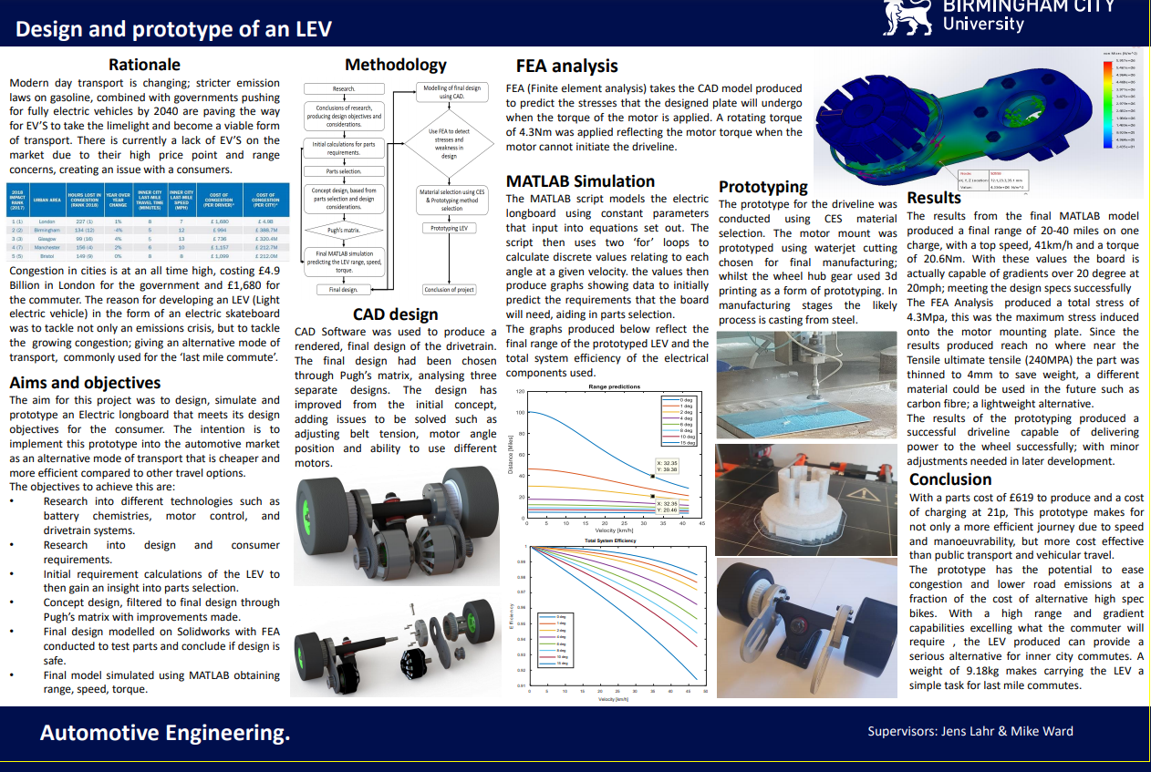

Slide 8
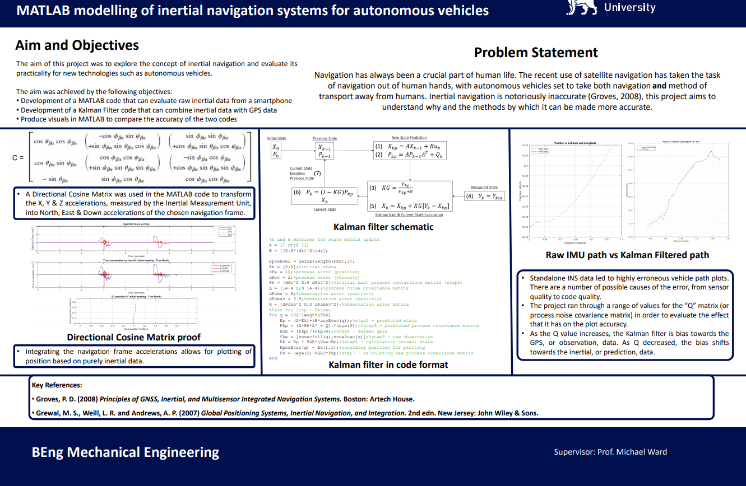

Slide 9
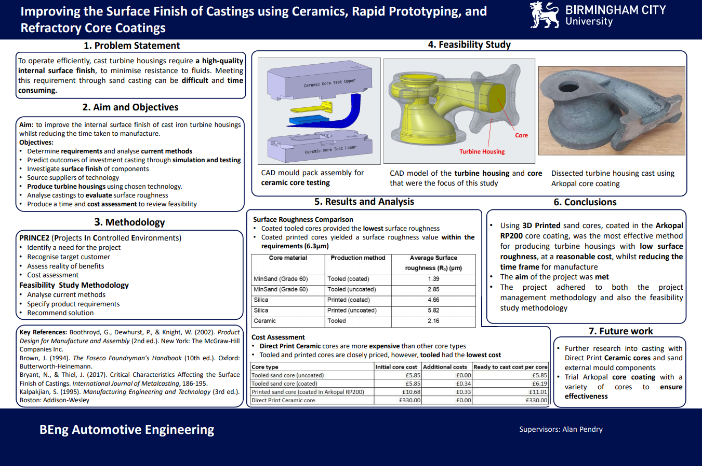

Slide 10
Final Points
Poster presentation and viva is a great opportunity to share your work.
Ensure they are kept concise and readable.
Ask for feedback on what you’ve produced, not on what you are going to produce.

